Slide 1

Madan Mohan Malaviya University of Technology, Gorakhpur (U.P.)
Presentation on-
An assessment of various Data Compression Techniques
Project Mentor-
Shri D.S. Singh
Presented By-
Shailendra Singh Verma(130210042)
Ravikant(130210037)
Tushar Verma(130210051)

Slide 2
Table of Content
Introduction
Why Data Compression?
Data Compression Methods
Lossy Data Compression
Lossless Data Compression
Proposed Compression algorithm
Proposed Decompression algorithm
Conclusion

Slide 3
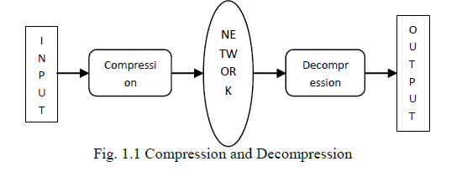
Introduction
Data compression is a process by which a file (Text, Audio, Video) may be transformed to another (compressed) file, such that the original file may be fully recovered from the original file without any loss of actual information.

Slide 4
Why Data Compression?
Make optimal use of limited storage space
Save time and help to optimize resources
If compression and decompression are done in I/O processor, less time is required to move data to or from storage subsystem, freeing I/O bus for other work
In sending data over communication line: less time to transmit and less storage to host

Slide 5
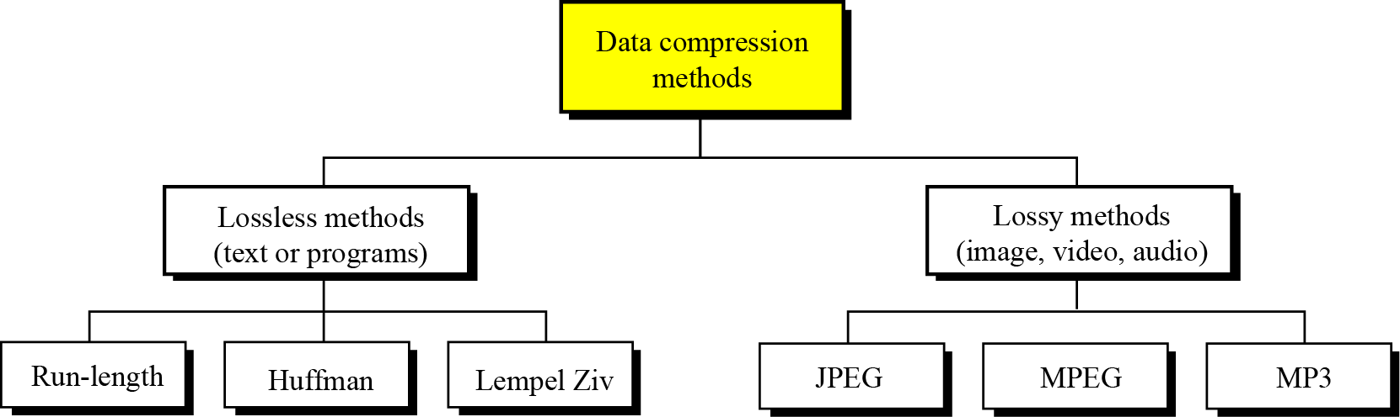
Data Compression Methods
Data compression is about storing and sending a smaller number of bits.
There’re two major categories for methods to compress data:
1.Lossless data compression
2. Lossy data compression

Slide 6
Lossy Compression
Lossy Compression also known as irreversible compression
Data after decompression may not be the same
Loss of data
Used for compress multimedia data
Methods of lossy compression
JPEG : compress pictures and graphics
MPEG : compress video
MP3 : compress audio

Slide 7
Lossless Compression
Lossless compression is opposite of lossy compression
Data after compression and decompression is same as original data
Mostly used for compressing important document
Redundant data is removed in compression but added in decompression
Methods of lossless compression
PNG : Raster graphics file format
GIF : Image File
ZIP : Archive file

Slide 8
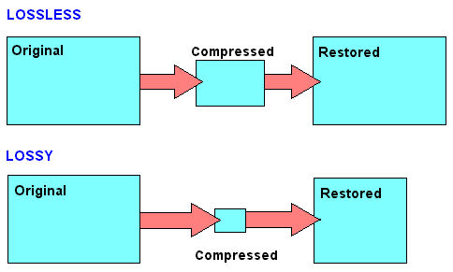
Lossless Vs Lossy

Slide 9
Proposed Compression Algorithm
Constraint : This Algorithm is for alpha numeric data only.
About : This algorithm reduces the standard 8 – bit data into 6 bit.
Steps Followed:-
Map the alphabets and numbers with the integers starting from 0.
Obtain the corresponding binary code of mapped values present in INPUT FILE.
Put these binary numbers into an array of byte (8-bit array), chop extra 2-bit from left.
Rearrange the bits to get 8 bits again.
Put the ASCII- Code of so obtained 8 bits.

Slide 10
Mapping
A : 0 a : 26 0 : 52 space : 62
B : 1 b : 27 1 : 53 new line : 63
- : - - : - - : -
- : - - : - - : -
Z : 25 z : 51 9 : 61

Slide 11
Example
Suppose our text message is “AnTo”
1. Binary representation of mapped values of particular
characters is :
A : 00000000 n : 00101000
T : 00010011 o : 00101001
2. After removing two bits from left we have A : 000000 n : 101000
T : 010011 o : 101001

Slide 12
Now shift left 2 bits of second character to first character. Left 4 bits of third character to second character. Right 2 bits of third character to fourth character. So we have : 000000 10|1000 0100|11 101001
Put the ASCII Code of formed 8 bit characters into a new file.

Slide 13
Proposed Decompression Algorithm
Steps Followed:-
Map the alphabets and numbers with the integers starting from 0 in reverse order as we did in compression.
Obtain the corresponding binary code of characters present in COMPRESSED FILE.
Put these binary numbers into an array of byte (8-bit array).
Rearrange the bits to get actual bits as it was in an input file.
Put the character of so formed bit after rearranging using map.

Slide 14
Mapping
0 : A 26 : a 52 : 0 62 : space
1 : B 27 : b 53 : 1 63 : new line
- : - - : - - : -
- : - - : - - : -
25 : Z 51 : z 61 : 9

Slide 15
Example
Suppose our binary equivalent of compressed file is
00000010 10000100 11101001
Perform the following slicing of bits
Remove first 6 bits of first character.
Combine right 2 bits of first character and first 4 bits of second character.
Combine right 4 bits of second character and first 2 bits of third character.
Remove left 6 bits of third character.
000000 | 10 1000 | 0100 11 | 101001

Slide 16
2. Print the mapped value of so obtained 6 bits. 3. We have obtained our previous data.

Slide 17
Compression Ratio
Compression ratio = Uncompressed file size .
Compressed file size
The compression ratio of proposed algortihm is 1.38 and space saving comes about 38% approximately.

Slide 18
Conclusion
The proposed algorithm works efficiently on messages containing alphanumeric characters. It can be viewed as a bit-slicing operation implemented on binary code of the mapped values for respective alphanumeric characters in the given message. This algorithm will always return constant compression ratio of 1.38 approx. and the space savings will be about 38% approx. Therefore, this algorithm can be considered suitable in streaming of message data across messaging devices and applications, provided they follow the constraint of including alphanumeric characters only.

Slide 19
References
Wade, Graham (1994). Signal coding and processing (2 ed.). Cambridge University Press. p. 34. ISBN 978-0-521-42336-6. Retrieved 2011-12-22. The broad objective of source coding is to exploit or remove 'inefficient' redundancy in the PCM source and thereby achieve a reduction in the overall source rate R.
Mahdi, O.A.; Mohammed, M.A.; Mohamed, A.J. (November 2012). "Implementing a Novel Approach and Convert Audio Compression to Text Coding via Hybrid Technique"(PDF). International Journal of Computer Science Issues. 9 (6, No. 3): 53–59. Retrieved 6 March 2013.
Pujar, J.H.; Kadlaskar, L.M. (May 2010). "A New Lossless Method of Image Compression and Decompression Using Huffman Coding Techniques". Journal of Theoretical and Applied Information Technology. 15 (1): 18–23.
Salomon, David (2008). A Concise Introduction to Data Compression. Berlin: Springer. ISBN 9781848000728.
S. Mittal and J. Vetter, "A Survey Of Architectural Approaches for Data Compression in Cache and Main Memory Systems", IEEE Transactions on Parallel and Distributed Systems, 2015.

Slide 20
Tank, M.K. (2011). Implementation of Limpel-Ziv algorithm for lossless compression using VHDL. Thinkquest 2010: Proceedings of the First International Conference on Contours of Computing Technology. Berlin: Springer. pp. 275–283.
Navqi, Saud; Naqvi, R.; Riaz, R.A.; Siddiqui, F. (April 2011). "Optimized RTL design and implementation of LZW algorithm for high bandwidth applications". Electrical Review. 2011 (4): 279–285.
Mahmud, Salauddin (March 2012). "An Improved Data Compression Method for General Data". International Journal of Scientific & Engineering Research. 3 (3): 2. Retrieved 6 March 2013.
Arcangel, Cory. "On Compression". Retrieved 6 March 2013.
S. Porwal, Y. Chaudhary, J. Joshi and M. Jain, “Data Compression Methodologies for Lossless Data and Comparison between Algorithms” International Journal of Engineering Science and Innovative Technology (IJESIT) Volume 2, Issue 2, March 2013
S. Shanmugasundaram and R. Lourdusamy, “A Comparative Study of Text Compression Algorithms” International Journal of Wisdom Based Computing, Vol. 1 (3), December 2011
S.R. Kodituwakku and U. S. Amarasinghe, "Comparison of Lossless Data Compression Algorithms for Text Data" Indian Journal of Computer Science and Engineering Vol1No. 4 416-425
Welch, Terry (1984). "A Technique for High-Performance Data Compression". Computer. 17 (6): 8–19. doi:10.1109/MC.1984.1659158

Slide 21
Thank You!

